Slide 1
Water Level Indicator System
05/11/2025

Slide 2
Introduction [1/2]
Water Level Indicator Overview:
Functionality:
The Water Level Indicator System is a smart and efficient solution for monitoring water levels in tanks.
Feature
This circuit not only indicates the amount of water present in the overhead tank, but also gives an alarm when the tank is full.
Empty Tank State:
When the tank is empty, tank wires are open, and a 220-ohm resistor pulls the switch low.

Slide 3
Introduction [2/2]
Filling Up:
As water fills the tank, it shorts the LOW indication wire, turning on LED1.
LEDs 2 and 3 light up gradually as the tank continues to fill.
Full Tank Alert:
When the tank is full, water raises the 2N2222 transistor's base, saturating it.
This saturation turns on the buzzer for an alert

Slide 4
Objective
The objective of a water level indicator is to provide a efficient solution for monitoring and managing water levels in tanks.
Real-time Monitoring
Alert System
Convenience
Cost-effectiveness

Slide 5
Scope
The benefits of water level indicator is :
Now no need to go on the roof to look the water level.
It shows the water level in your room like 1/4 tank ,1/2 tank and full tank.
Alarm starts ringing as soon as tank becomes full suitable for every tank.
This process will help us to reduce the wastage of water and electricity.

Slide 6
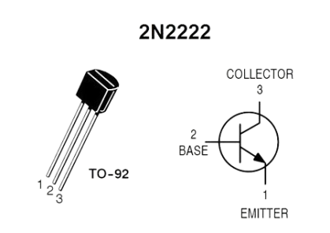
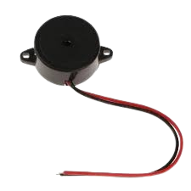
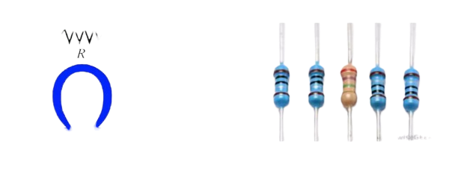
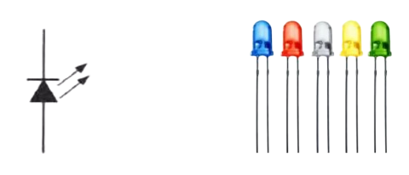
Components
DMM(Digital Multimeter)
Vero board
Jumper wires
Soldering wire
Soldering iron
Filler
Stucker
7404 IC
LED
Resister
Transistor(2N2222)
Electric Buzzer

Slide 7
Problem Statement
Need of this project is to avoid wastage of water.

Slide 8
Constraints
Availability of components
Testing on Bread Board
Implementation on Vero Board

Slide 9
Working [1/4]
Working of components
Battery .
Is used to give the voltage to our circuit.
Resistors.
Is used to resist the over flow of current.
Transistors.
Is used as switch in this circuit for an input provided.

Slide 10
Working [2/4]
Light emitting diodes.
Is used to interpret result on the output signal.
Buzzer
Is used as an alert alarm that indicates overflow of water.
NOT gate IC.
Is used to invert the signal received from transistor.

Slide 11
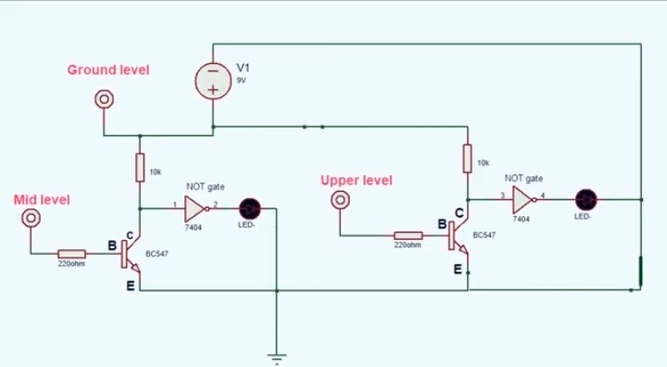
Working [3/4]
CIRCUIT Diagram:

Slide 12
Working [4/4]
We can use any type of sensor, we used a conducting wires as sensor.
Whenever the particular sensor sense the level of water, the circuit will complete and current starts flowing, results in the glowing of LED which show the particular level of water in water tank.

Slide 13
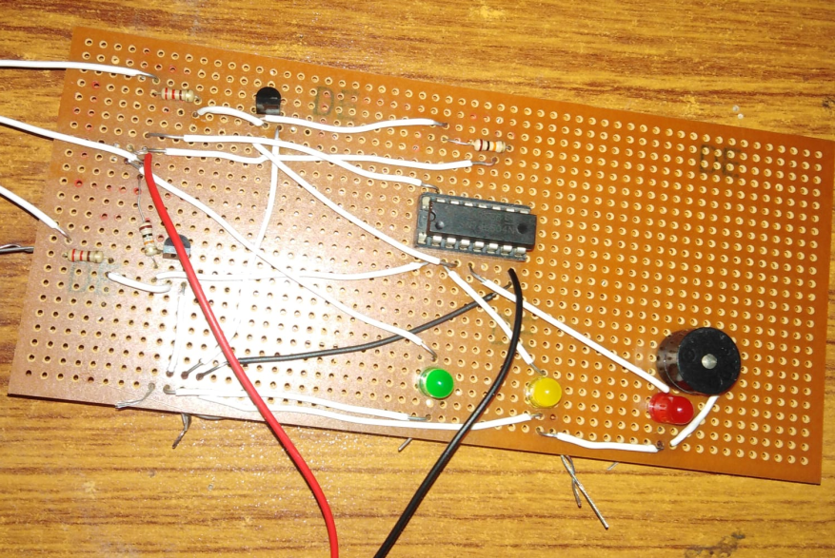
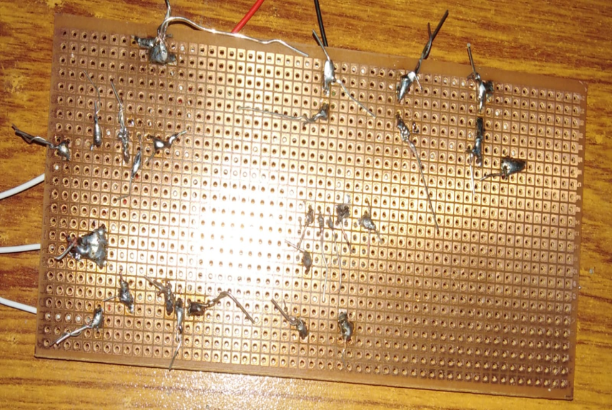
Circuit

Slide 14

Thanks For Listening Have a good day!!

